Slide 1
Situational Awareness
Guidance and Training Material
September 2025

Slide 2
Situational Awareness
Following slides to be briefed to all personnel

Slide 3
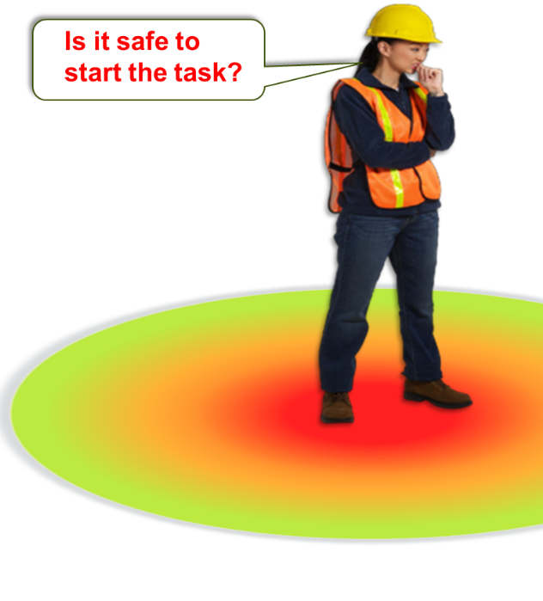
Situational Awareness
What is it?
Situational awareness in health and safety is defined as “being aware of what is happening around you in terms of where you are, where you are supposed to be, and whether anyone or anything around you is a threat to your health and safety”. ​
Maintaining situational awareness is an ongoing and dynamic process and requires continuous attention, vigilance, and the ability to adapt to changing circumstances.

Slide 4



Being aware of what's around you
Situational Awareness
Situational awareness is being aware of what is happening around you. This includes where you are, where you’re supposed to be, and whether anyone or anything around you is a risk to your health and safety.
Initial Site Observation
Assess Visibility
Traffic Conditions
Animal Presence
Weather Conditions
Emergency Exits and Safe Zones
Communication Tools and Plans
Personal Protective Equipment (PPE)
Potential Interactions
Escape Plan
Vehicle Security:
Continual Monitoring:
Documentation:
Secondary
Steps of Dynamic Assessment checklist
Immediate
10m
3m
3m
10m

Slide 5
Situational Awareness
Add in your own company procedures if applicable

Slide 6
Situational Awareness
Following the briefing, arrange for following exercises to take place

Slide 7



Situational Awareness
How will it be delivered?
E-Learning for Knowledge
Completed by end of Sept 25
Practical Exercises for Skills
Completed by end of Oct-25
Monitor to check Behaviours
Completed by end of Dec-25
Notes:
E- Learning for all direct staff
Practical exercise to be arranged for relevant personnel as depicted on slides

Slide 8



Situational Awareness – guidance for facilitators
Items to note
In TW family we have many ex-military personnel. Many ex-military will know exercise 1 and 2 already as they are the same exercises trained in the British Army. Managers have the flexibility to delivery in their areas how they want.
Could you use someone ex-military?
Do you want to combine the session with another team and work together?
Do you wish to add more H&S items as part of a standdown?
Explain we have seen preventable incidents where harm could have been avoided if we were more aware of our surroundings
This is only human; our physical surroundings change all the time, this could be due to timings of the day, weather or what work activity is being conducted around us and our sensation and attention differ throughout the day
In Jan we statistically see a spike in incidents. This initiative is being launched now to try prevent this spike.
The skills pack needs to be done in person from you to the team
If you need assistance please contact your H&S Lead / Advisor
On the day the skills are practiced on site, a projector/laptop/meeting room isn’t required.
E-Learning will give the knowledge, the skills element needs to be done on a working site that is safe to use, with some space to perform the exercises

Slide 9
Situational Awareness
Step 1- Arrange E-learning for all staff

Slide 10
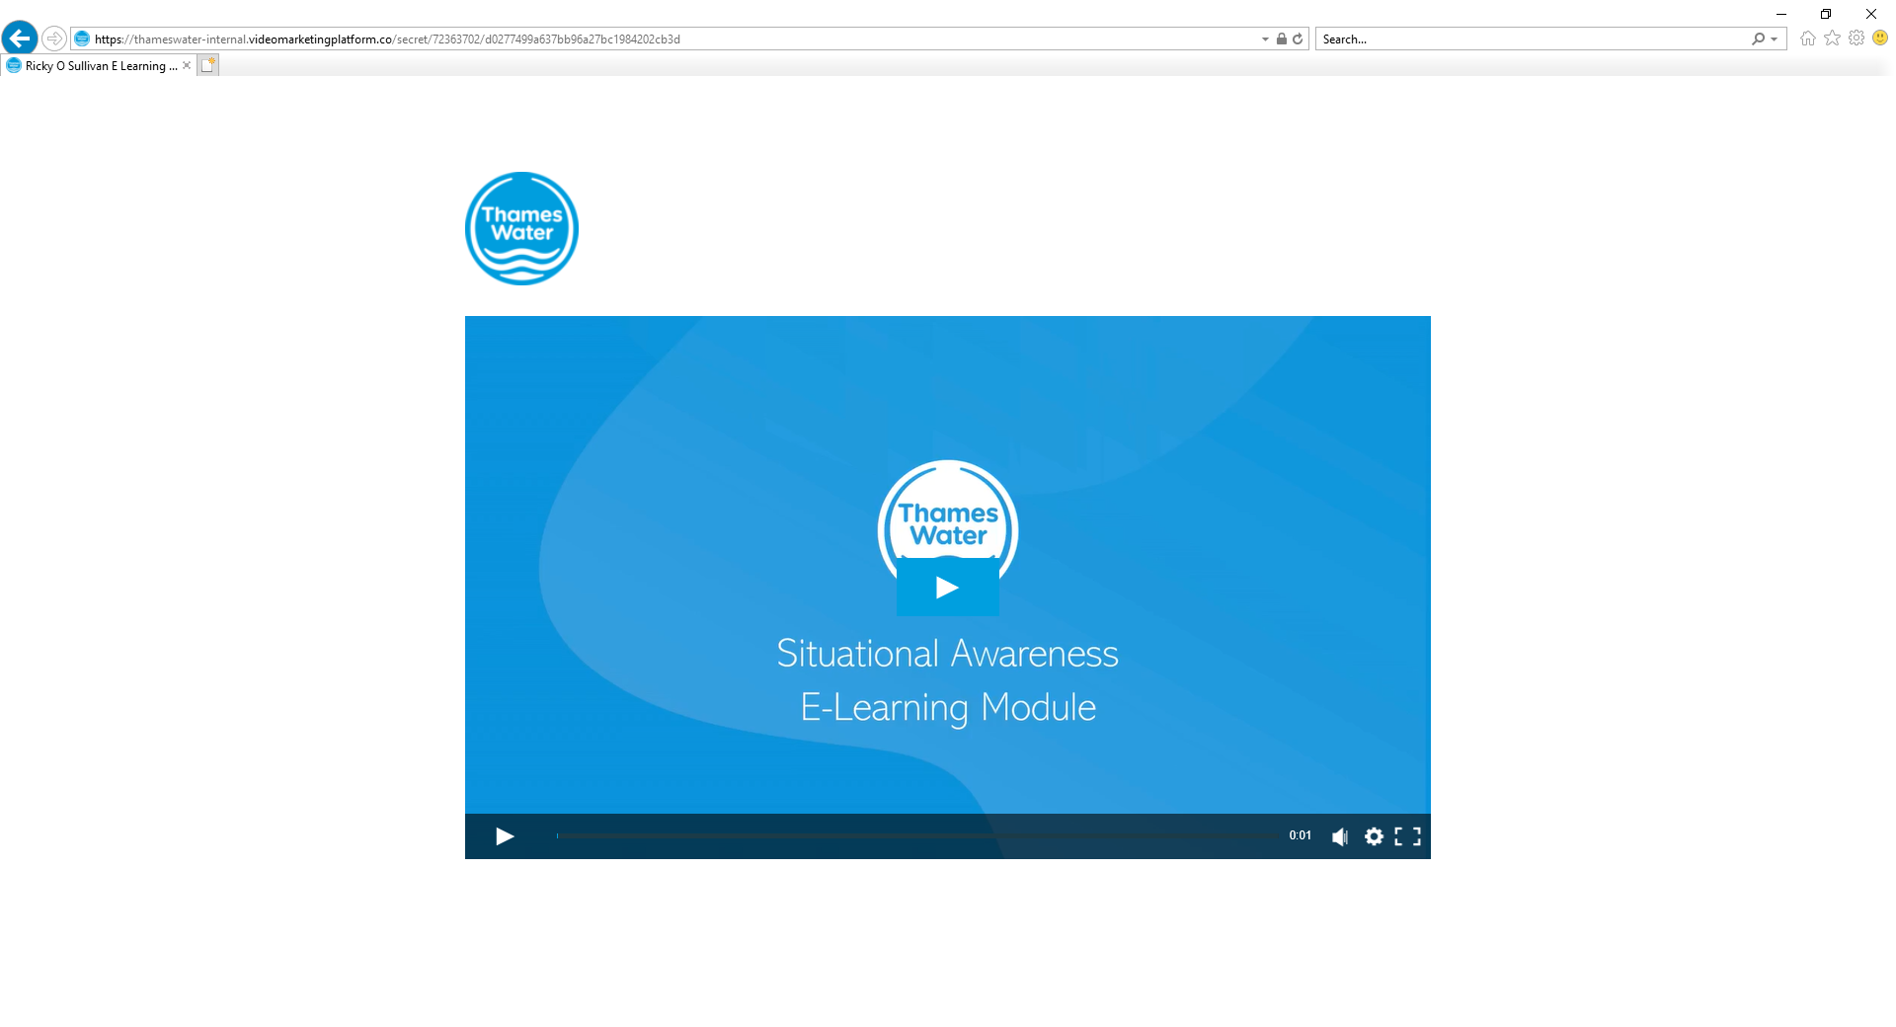
E-Learning
Everyone to complete this E-learning and completion to be recorded
E-Learning Link – copy & paste below link to your browser
https://sanehighhealthsafetydocs.blob.core.windows.net/twul/Thames_Water/Video_gallery/Situational Awareness.mp4

Slide 11
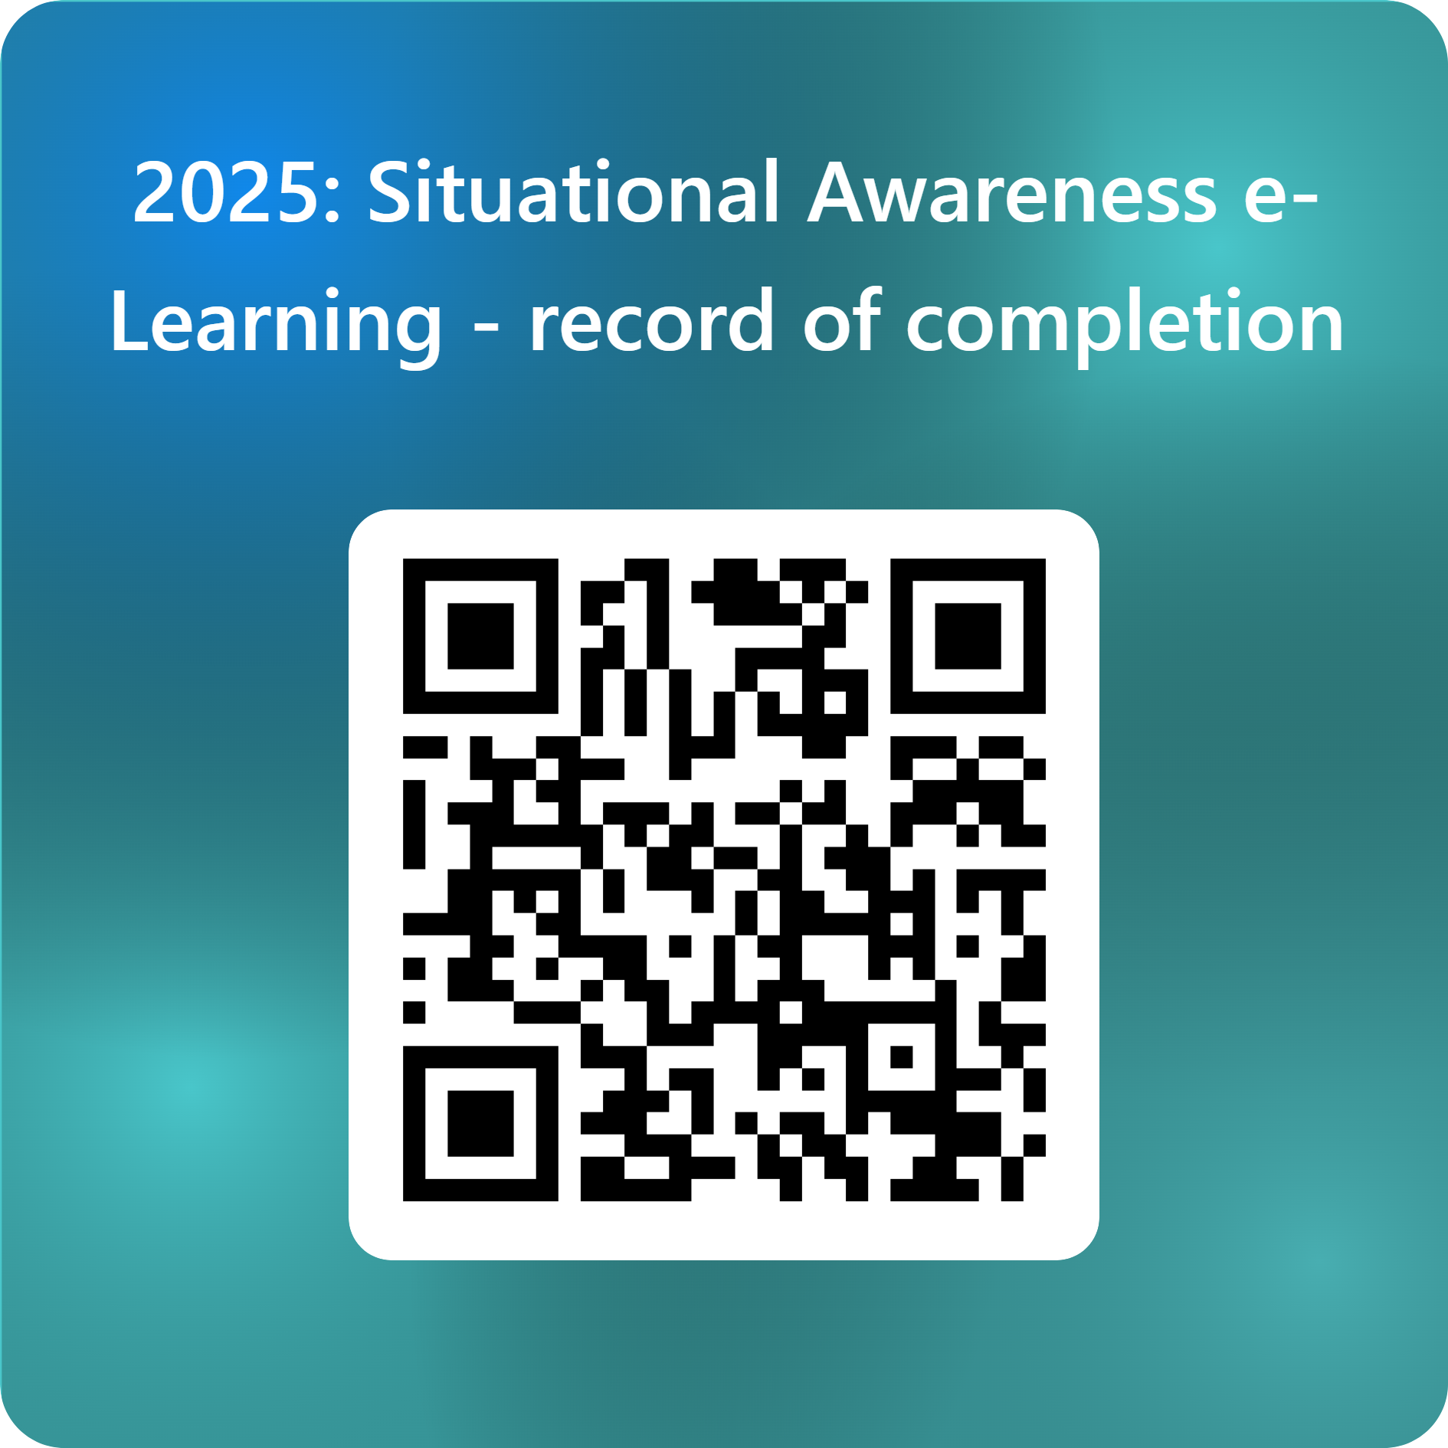
All to complete by end of Sept 2025
Please scan the QR code and complete the form to confirm your completion of the e-learning module.
Or use the URL link below:
Situational Awareness: E-Learning record of completion

Slide 12
Situational Awareness
Step 2- Brief Slides 1-3 & then Complete Practical Exercise alongside Slides

Slide 13
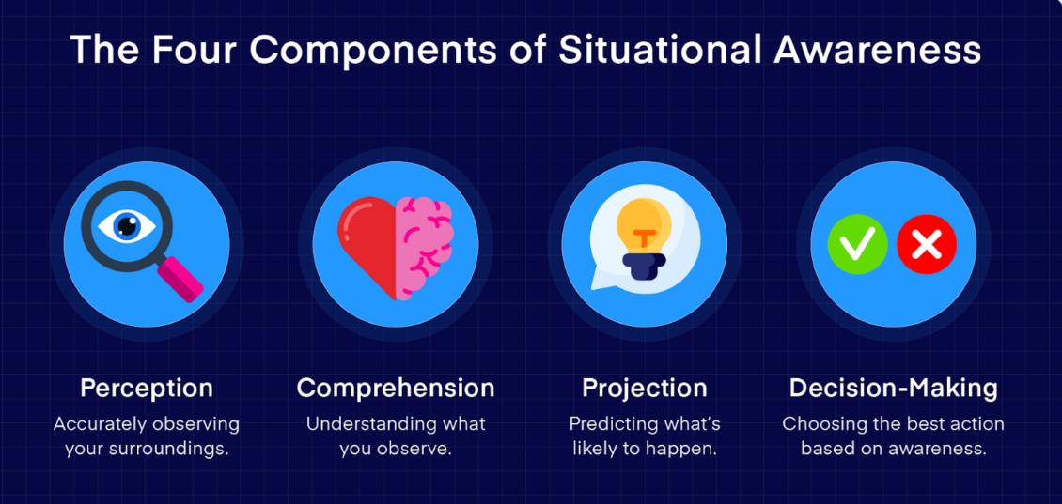
1. Situational Awareness
Changes;

Slide 14
2. Situational Awareness
Changes:
Conditions can change significantly at any time, or we can become accustomed to hazards over time.​
Therefore, active monitoring (3m & 10m) is most useful before and during a task. ​
Situational awareness enables the following:​
Identify the hazards most applicable to the activity or which may be new/unforeseen​
Ensure the right controls are in place for work to be done safely​
Provides a simple concept to combat Inattentional Blindless

Slide 15
Secondary
3. Situational Awareness
Primary
How to Improve SA?
Step 1 – primary area
Visually check the 3m radius.
Repeat process continuously as you move around site.
Identify best safe position to stop.
If in a vehicle, from inside the vehicle, visually check the first 3m radius.
Look down first, if no hazards, then step out.
Complete a visual 3m radius check from ground up and above head height.
Complete a physical check only in the 3m radius.
10m
3m
3m
10m
Step 2 – secondary area
Only to be done once 3m check is complete.
Visually check the 10m radius.
Once visual check is complete, do a physical check of 10m radius.
Repeat process continuously as you move around site.
Ensure no one can come to harm, barrier off the area/put controls in place to prevent harm.
Report any hazards as Spherecloud or equivalent delivery partner system
If no controls can be put in place, stop work and inform your manager
Notes:
Red to be adapted to company process

Slide 16
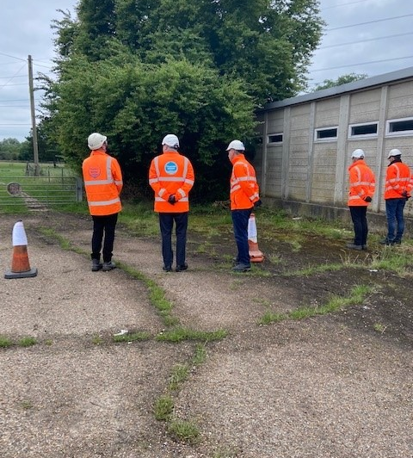
Exercise 1A- (Office staff)
Scanning for hazards
Gather 6-10 non hazardous objects to hide. These can be anything from balls to stationary. These objects represent hazards
Hide these in various places where they can actually be seen but partially hidden over a safe area. Use floor level and above head height if possible
Get candidates to stand in a line facing the objects. They can't walk towards them but can walk side to side on the defined line. Maximum of 8 candidates work better.
Time them 3 minutes to find the objects.
At the end of the 3 minutes ask each candidate to share with the group how many they spotted but not where they think they are.
Ask each candidate to walk directly to 1 object they have seen. They need to walk to the nearest object from the defined line used to search from
Review if they have all be found
Rules:
When candidates are looking for the objects in the 3-minute period they cannot talk to each other, point to the objects or help each other in anyway. Can someone ex-military within TW assist?
Do not tell candidates how many objects have been planted until after they have all completed step 6 and said how many they have spotted. This symbolises that when we arrive on site, we don’t know how many hazards there are or what they look like. We have to scan and determine ourselves.
Purpose: This is to show it is difficult to spot hazards from a static position. As we walk through a site by correctly scanning all the time you will be able to spot hazards better. Also, we are only using 1 of our senses (eyes). This symbolises how hard hazards can be to spot so we need to be very observant and always scanning our surroundings. Scanning large areas is difficult so we need to break the area into smaller parts to make it easier.
Line not to cross and to scan for objects from

Slide 17
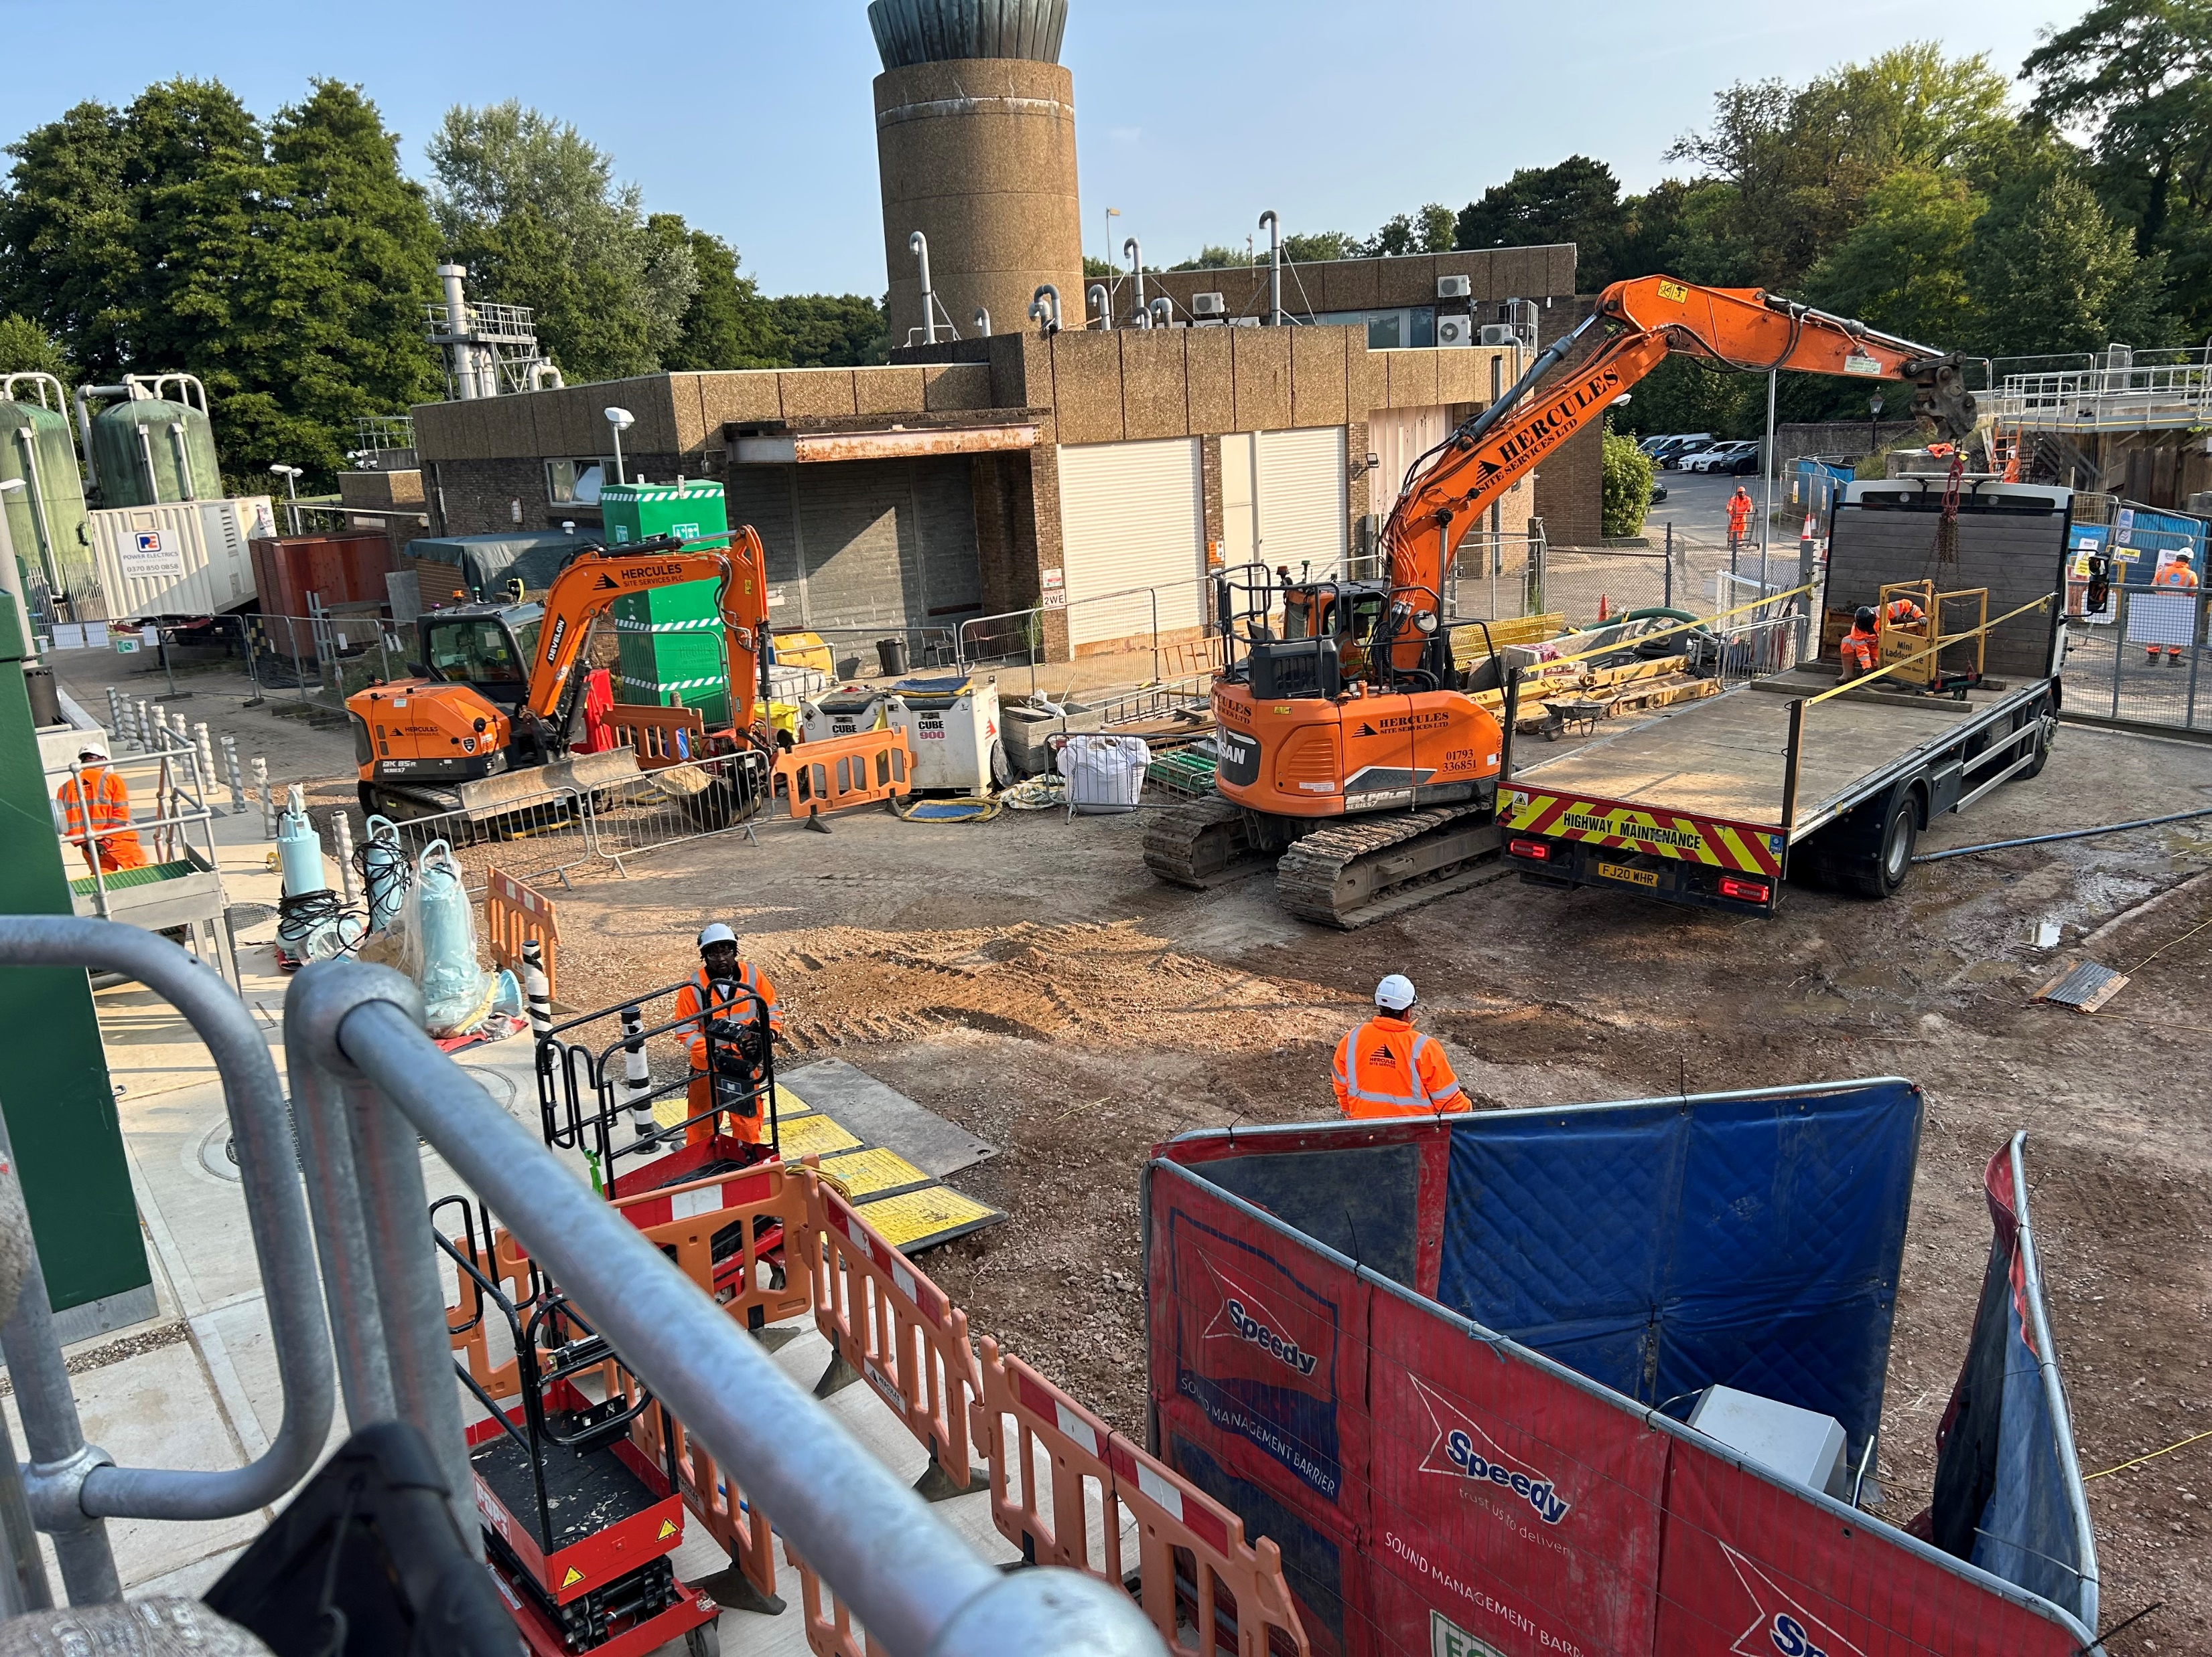
Exercise 1B (site staff)
Scanning for hazards
SLT/SPM/PM/CM (Management Personnel) to go to site and review the daily briefing for the day.
Once done, take the team out to site and get them to stand in view of the working area and begin discussing the hazards they can see onsite based on their activities for the day
To consider:
What is around you in terms of physical environment?
What other activities in the area could impact you?
What could go wrong? – how would you react to this?
Back to the daily briefing:
What we covered in the daily briefing was that picked up in the chat? If not, why not?
Any safety observations identified to reported on Spheracloud (or delivery partner equivalent system)

Slide 18

Secondary
Exercise 2 (All)
Immediate
Completing 3 & 10 from vehicle
10m
3m
3m
10m
This is where you will go through the full 3 & 10 checks as per the instructions on the right.
Either do this yourself and talk through what you are doing, or get candidates to do this sequence and ask the group ‘what do they do next’
Rules:
You can adapt this to how it works best for your group or the area you have. You need to repeat this task until you are confident the whole group can remember the sequence
Purpose:
To ensure candidates can remember this sequence so they can apply it moving forward
3m
Identify best safe position to stop
From inside the vehicle visually check the first 3m radius
Look down firstly, if no hazards step out
Complete a visual 3m radius check from ground to up and above head height.
Complete a physical check only in the 3m radius
10m
Only to be done once 3m checks are complete
Visually check the 10m radius
Once visual check is complete, do a physical check of 10m radius

Slide 19
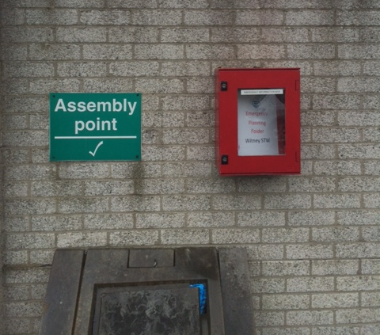
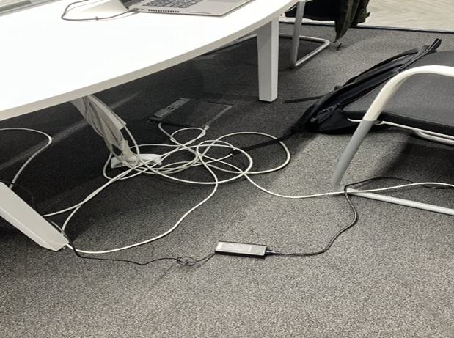
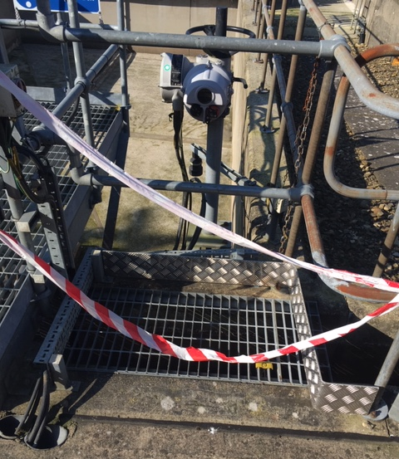
Exercise 3 – (All)
Site emergency file
Applying in the workplace
Fire assembly point
Now get candidates to go onto a working site / working office and apply the 3 & 10 checks. What hazards can they see? What mitigation needs to be put in place? Also what can they see that will help them? i.e. warning signs? Site lighting? Fire extinguishers? Some examples of what to spot for are shown on the right
Rules:
Ensure full PPE is worn as required and adhere to the site rules
Ensure any hazards have mitigation put in place/make safe and anything found is logged on Spheracloud (or delivery partner equivalent system)
Candidates to share their findings to the group afterwards
Purpose:
To show how the 3 & 10 checks work in your workplace. This is a chance to spot hazards and report safety observations and put controls in place to make safe. Also get candidates to shout out things that will make them work safer. For example, where is the designated pathway? Where is the fire exit? Where is the fire alarm call point? What warning signs can they see to alert them to harm?
Grit bin to prevent slips in adverse weather
Trailing leads
Barrier tape to warn of hazard. Do not go past
Grating clips missing

Slide 20
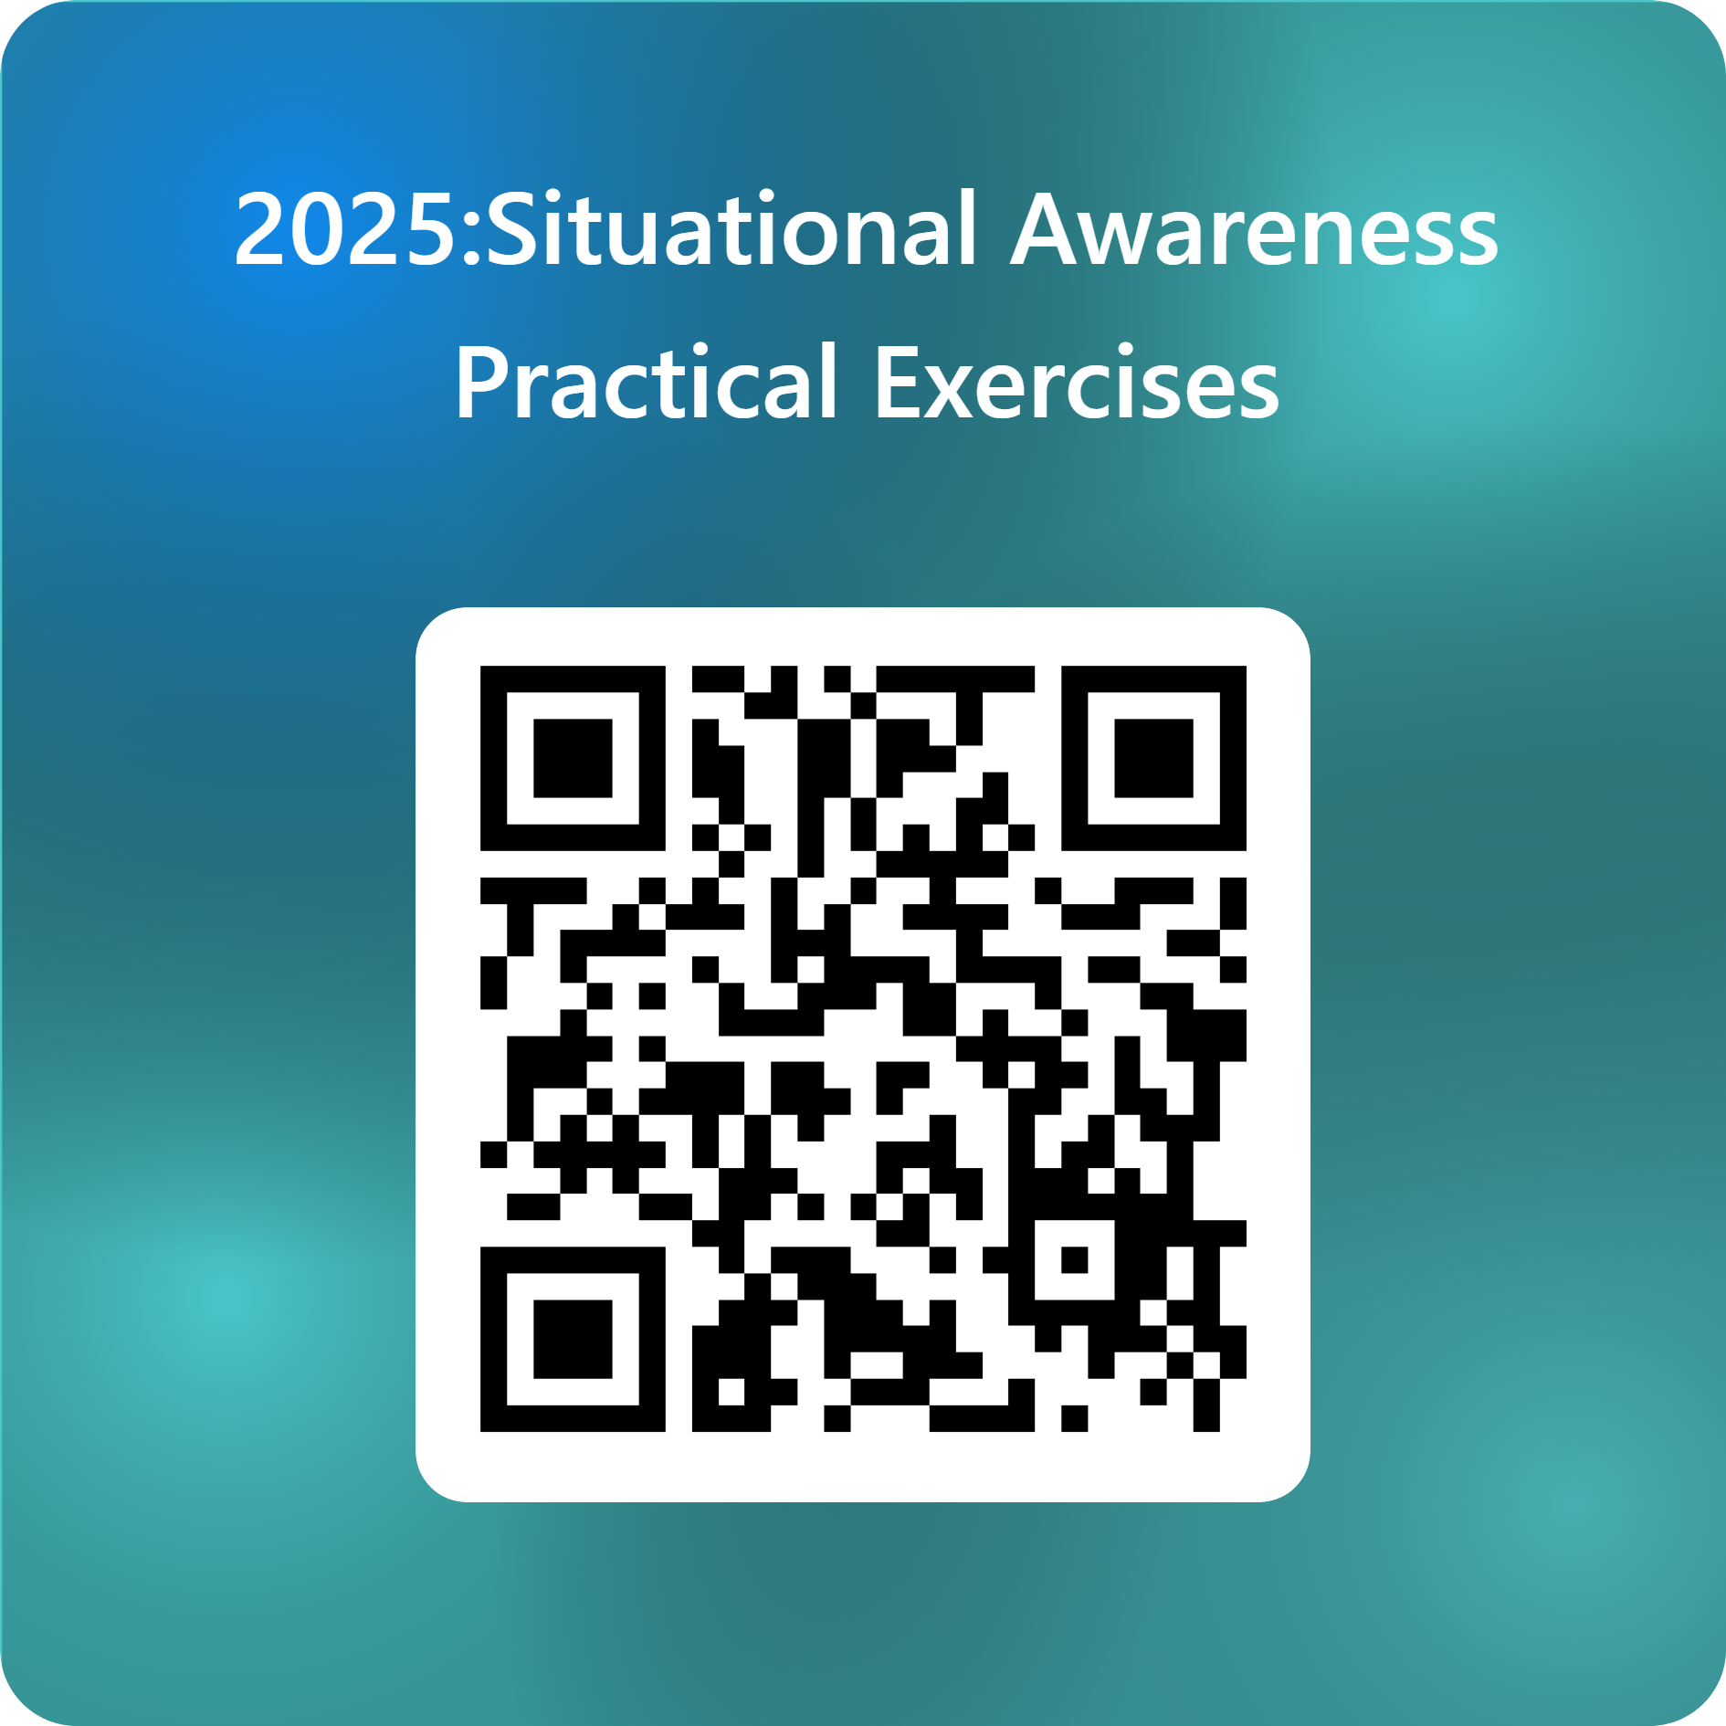
All to complete by end of October 2025 2025
Please scan the QR code, complete the form & submit to confirm your completion of the exercises.
Or use the URL link below:
Situational Awareness: Practical Exercises record of completion

Slide 21
If you have any further questions contact your SHEQ Representative or Paresh Kavia

